Slide 1
Survey Data Analysis USING PYTHON
Company : Missioned
Data science internship
Name : Jeeva K
Date : 06/08/2021

Slide 2
In this analysis to collect different types of data from users. All data collected via google forms and it stored in Excel Format. The Excel Sheet(Contact_Information) dataset containing 7 columns like Timestamp, Gender, Age, City, State, Pincode, Product Category, So, we have to analyze data and meaningful insights from it

Slide 3
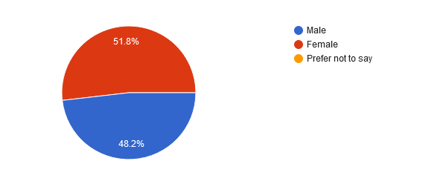
Survey data : Gender

Slide 4
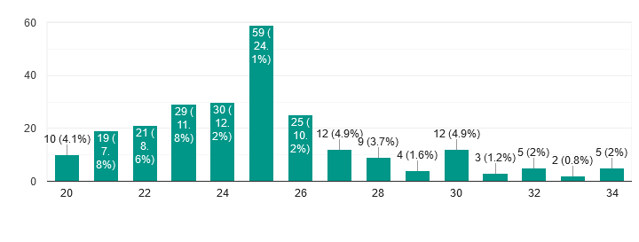
Survey data : Age Category

Slide 5
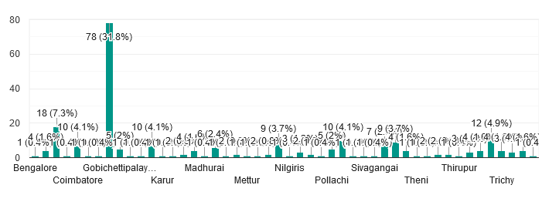
Survey data : City Categories

Slide 6
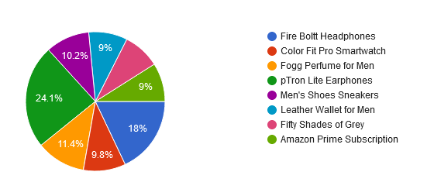
Survey data : Product Category

Slide 7
Data Exploration
Data exploration is a key aspect of data analysis and model building. Without spending significant time on understanding the data and its patterns one cannot expect to build efficient predictive models. Data exploration takes major chunk of time in a data science project comprising of data cleaning and preprocessing

Slide 8
Data Preprocessing Techniques
Missing values
Data Cleaning
Extract Features
Feature Encoding
Label Encoding
Handle Outliers
Separate Independent and dependent Features
then Select best Feature

Slide 9
Data Visualization
Data visualization is the graphical representation of data in order to explore and visualize data to uncover insights from the start or identify areas or patterns to dig into more.
Using interactive dashboards and point-and-click data exploration, users can better understand the bigger picture and get to insights faster.

Slide 10
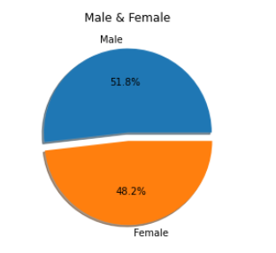
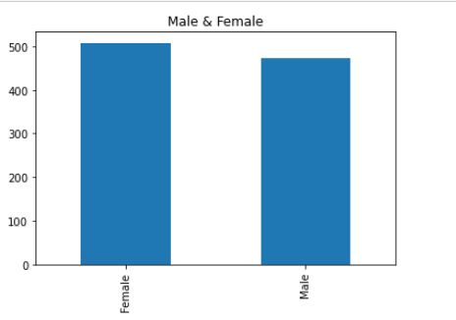
Gender Category

Slide 11
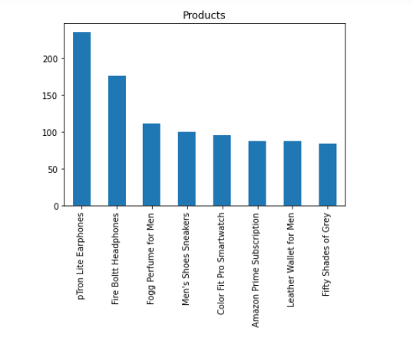
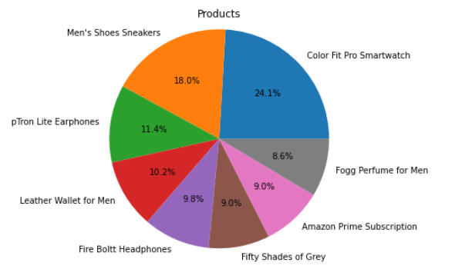
Product Category

Slide 12
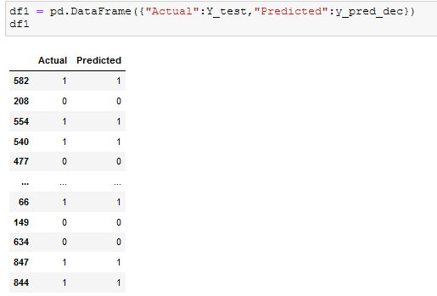
DecisionTreeClassifier
Decision Tree use to solve different kind of problems like Regression and Classification and It's a Rule based kind of thing. Decision Tree is according to divide into two variables and it's just making decision

Slide 13
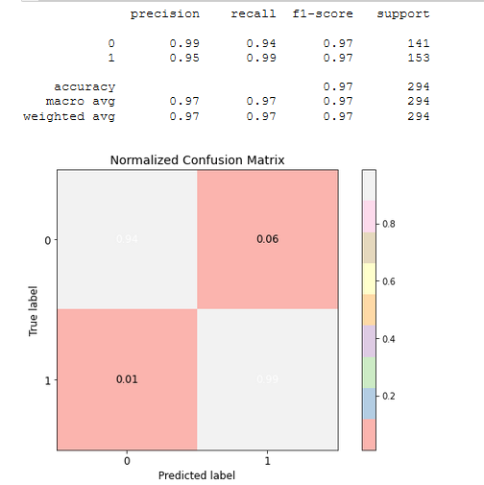
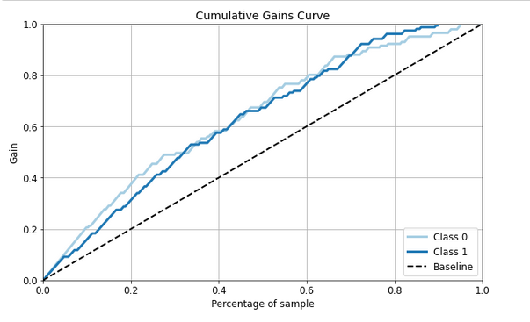

Normalized confusion matrix and Accuracy

Slide 14
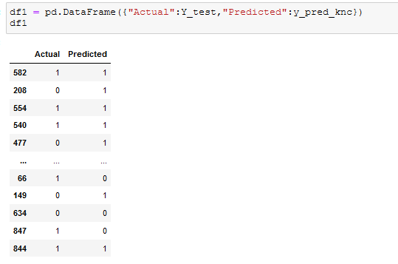
K Neighbors Classifier
The k-Nearest-Neighbor Classifier (kNN) works directly on the learned samples, instead of creating rules compared to other classification methods

Slide 15
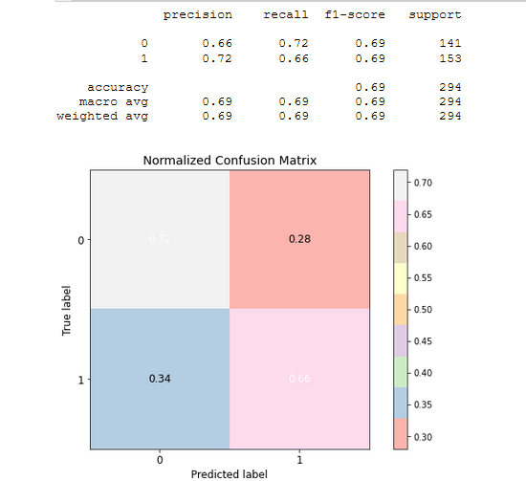
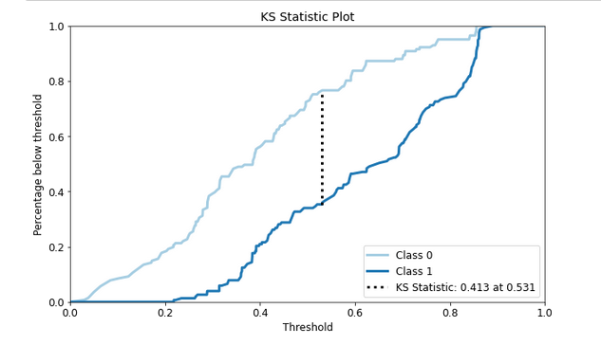
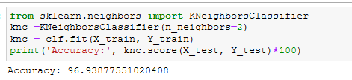
Normalized confusion matrix and Accuracy

Slide 16
Thank You

